Slide 1
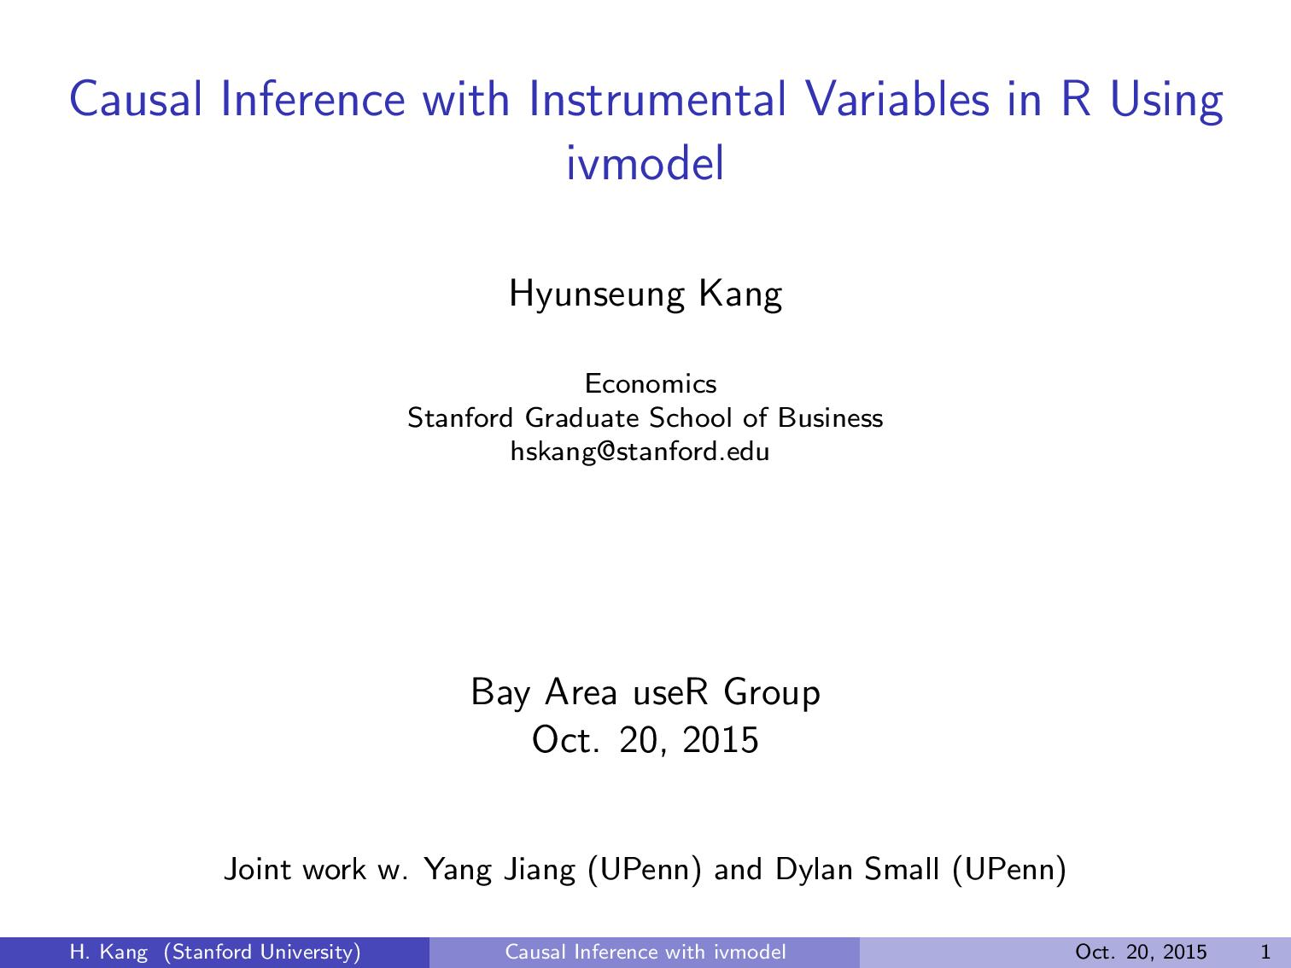

Slide 2
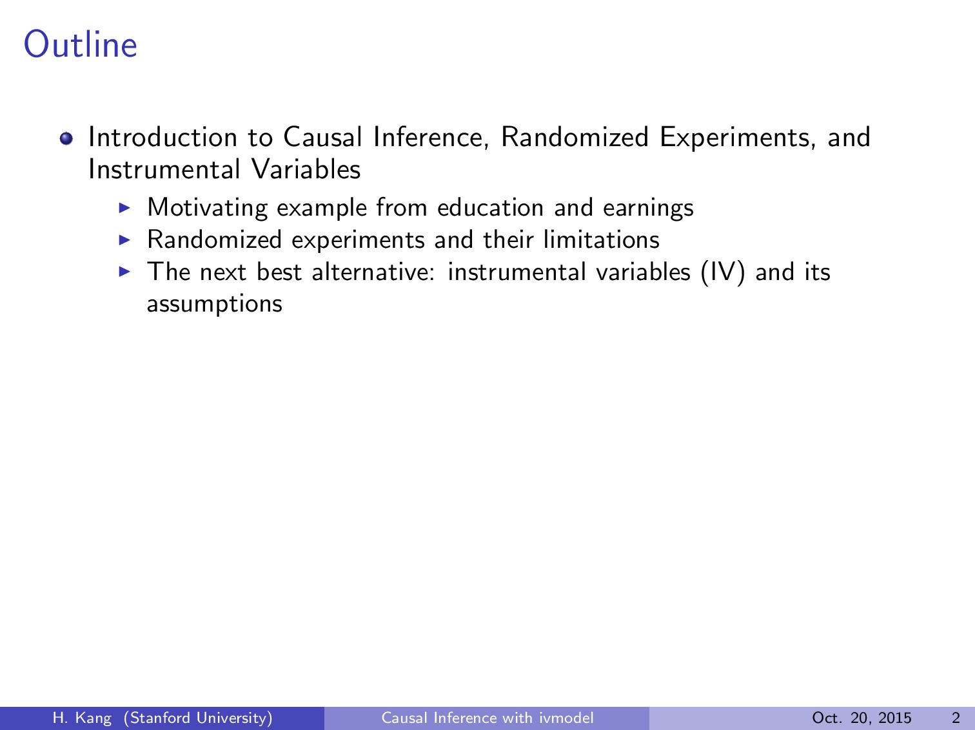

Slide 3
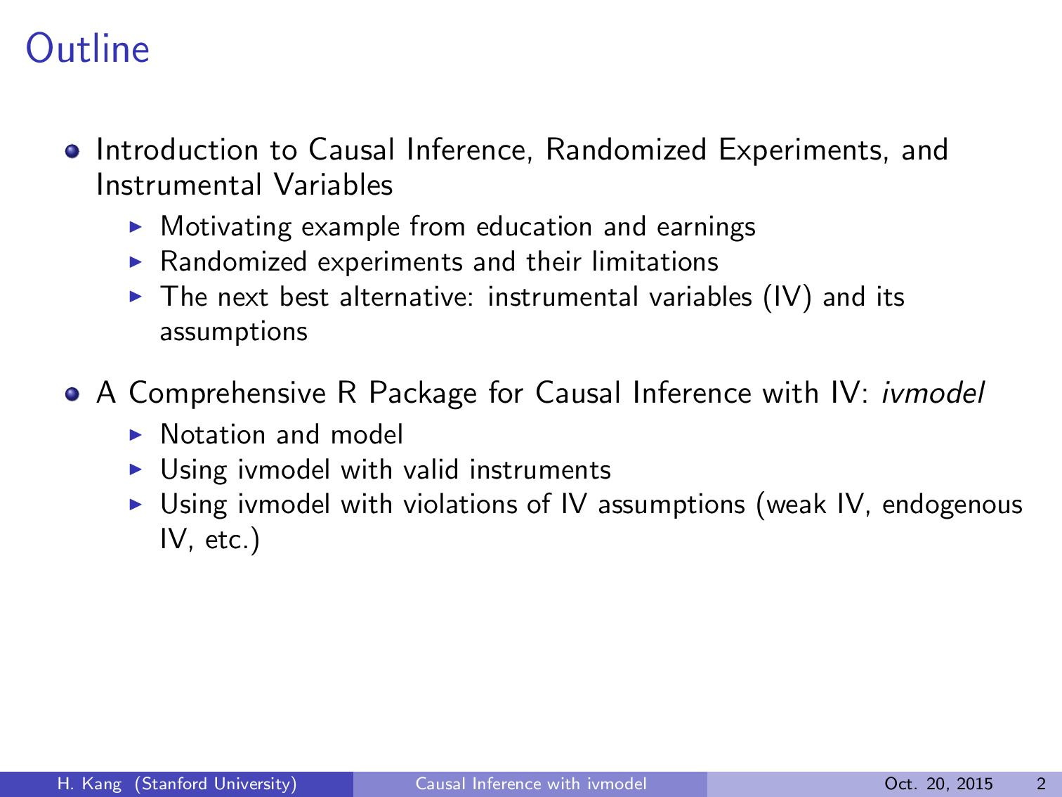

Slide 4
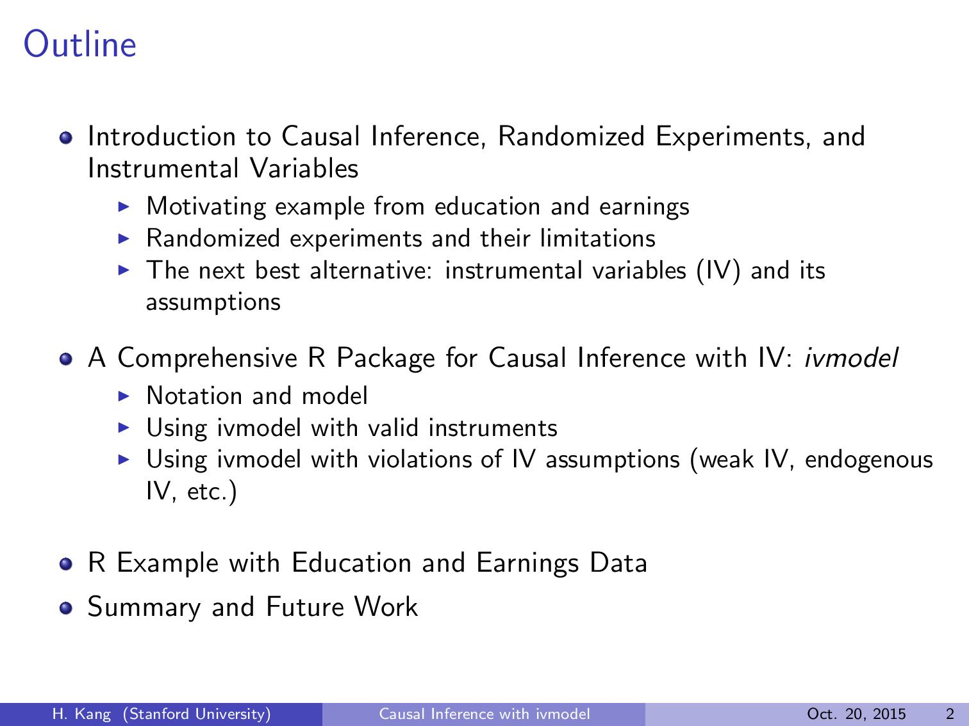

Slide 5


Slide 6


Slide 7
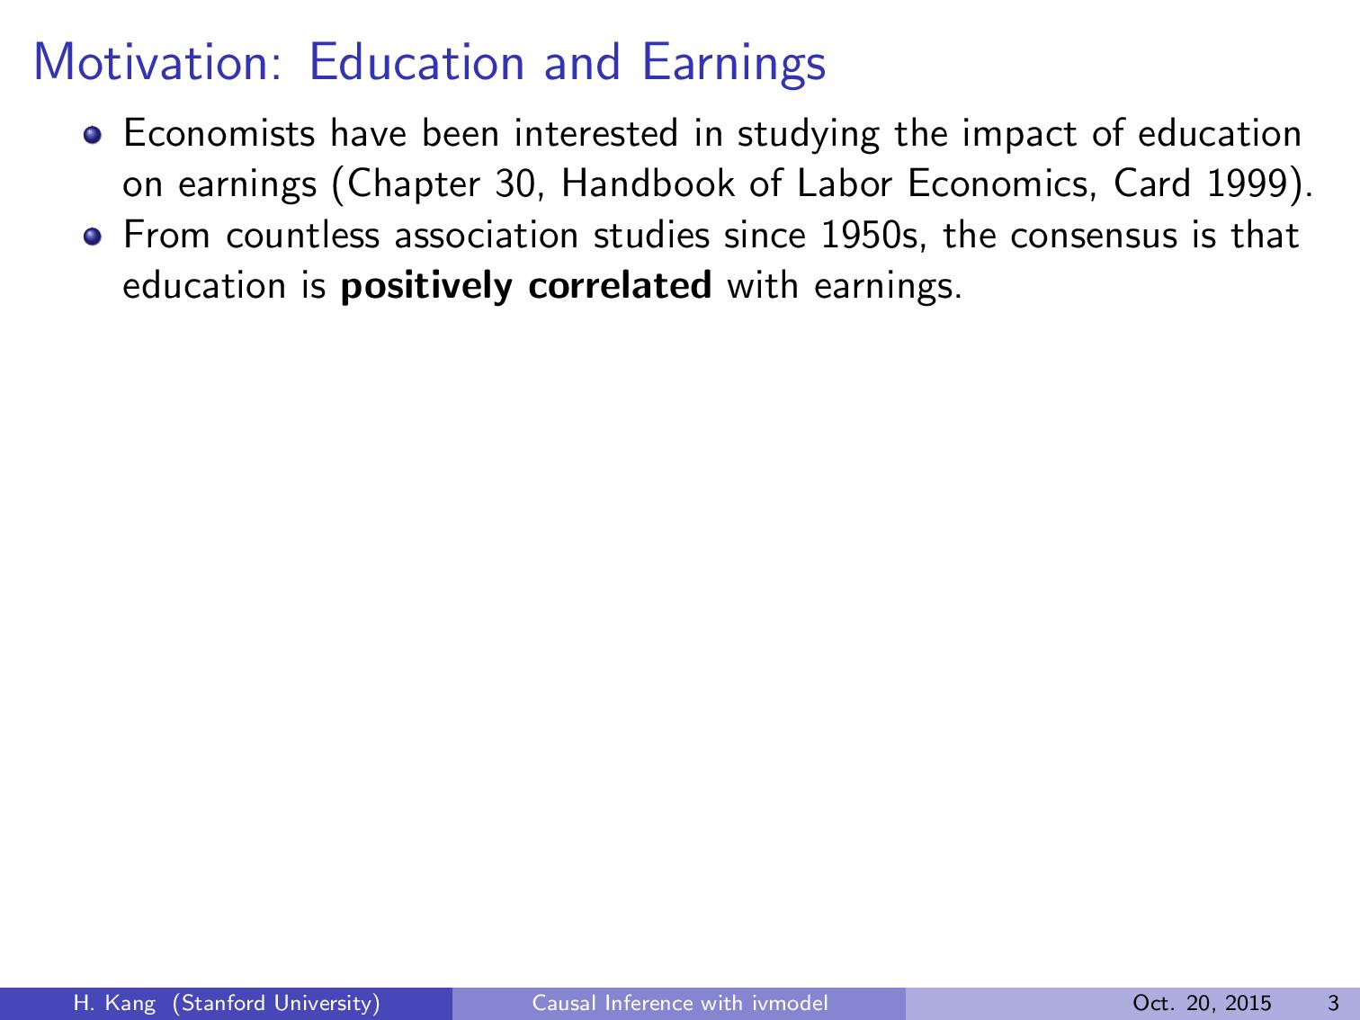

Slide 8


Slide 9
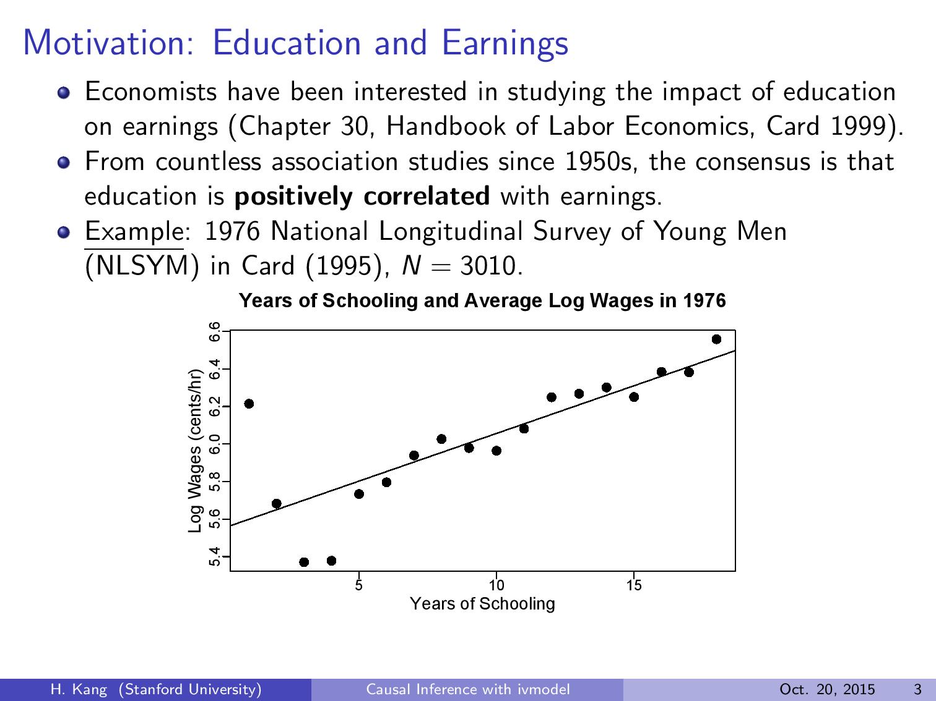

Slide 10
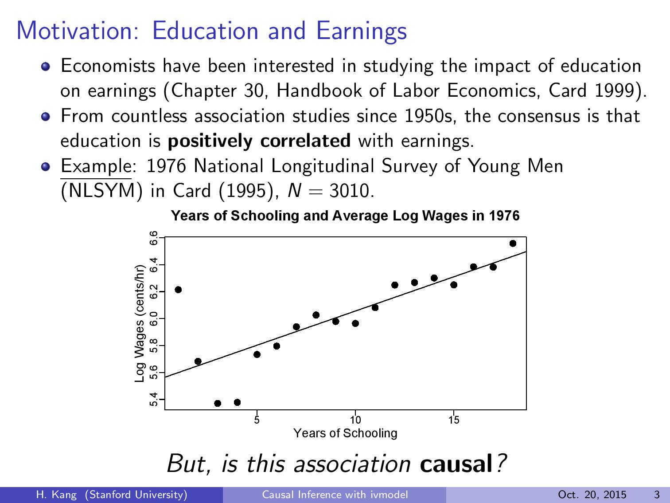

Slide 11
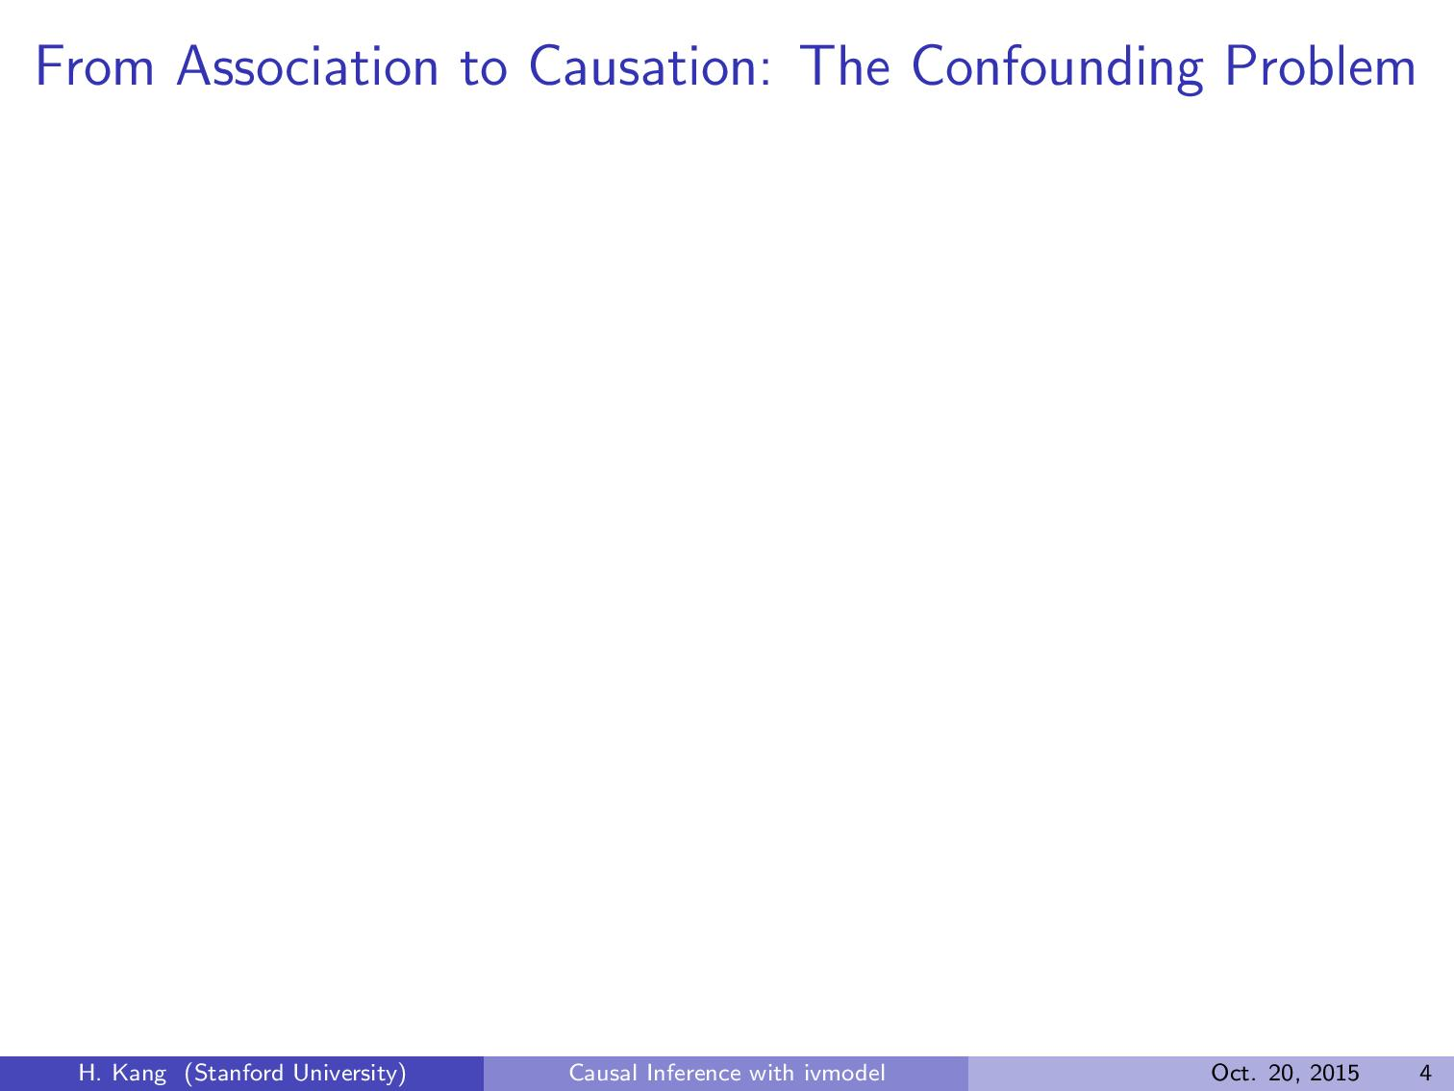

Slide 12
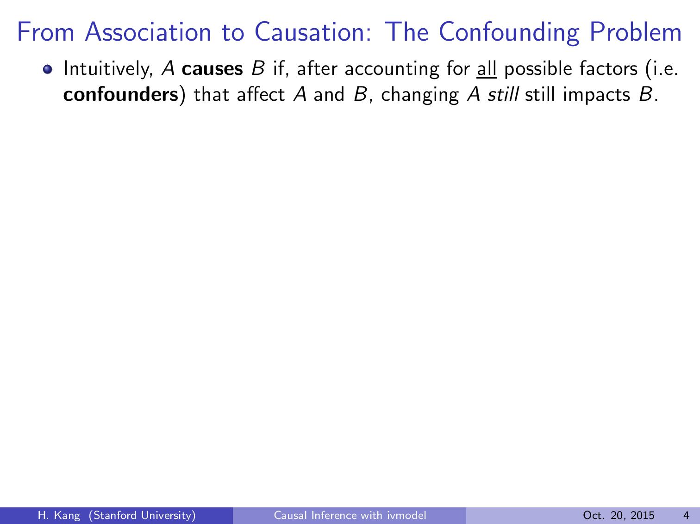

Slide 13
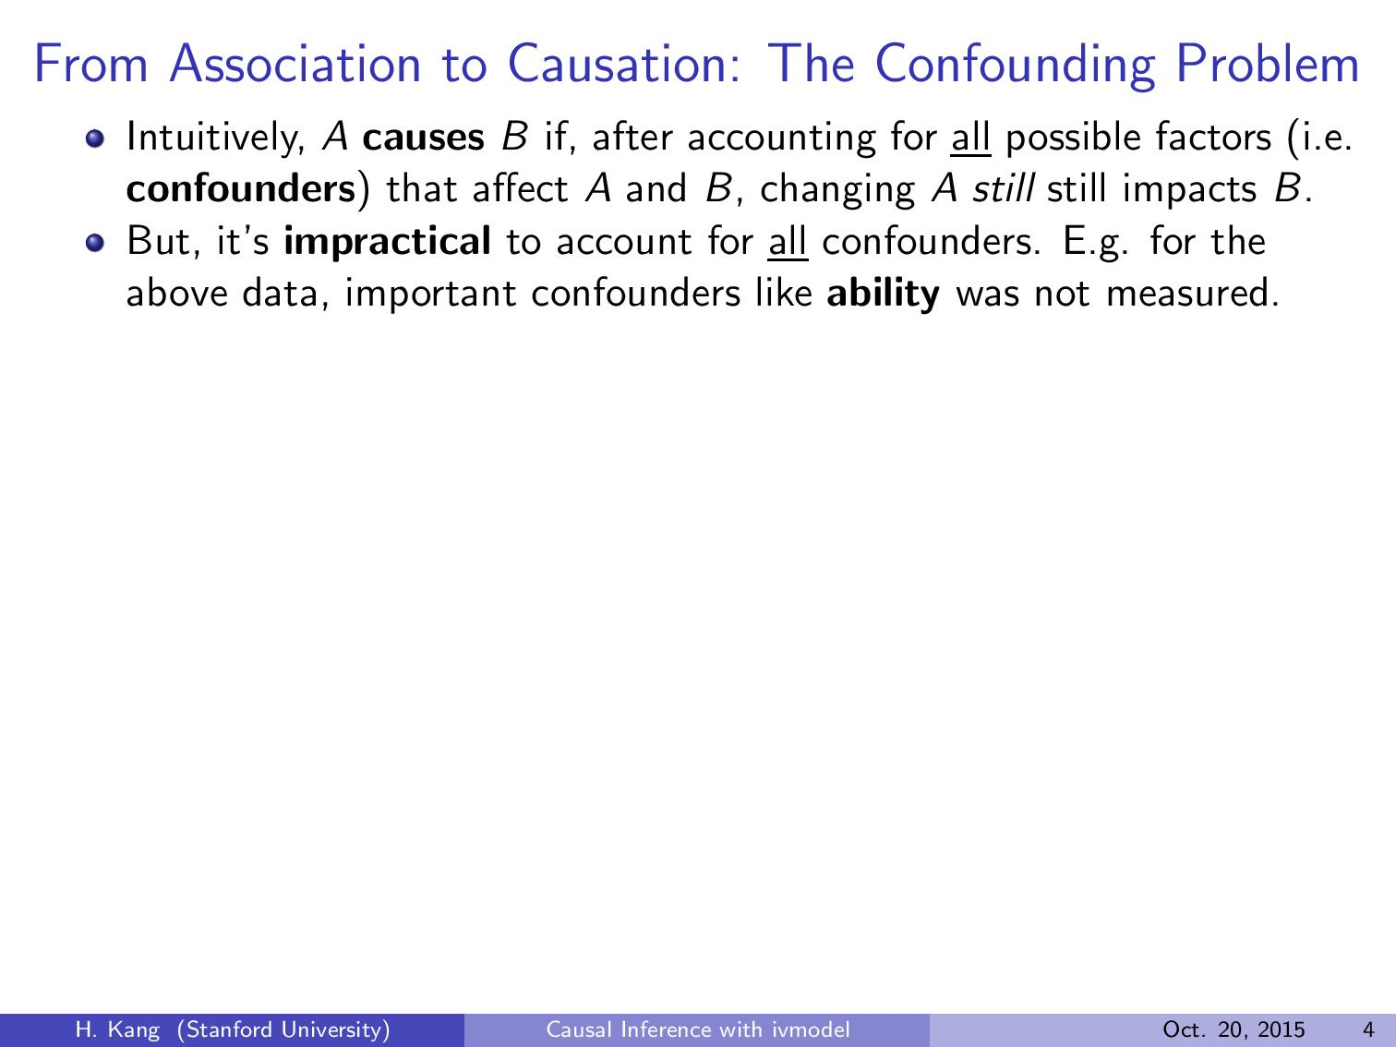

Those who have better ``ability’’ tend to have higher edu. and earn more!
No College
College Graduates
Unmeasured Confounders
(Ability)
Exposure
(Edu)
Outcome
(Earning)
No Unmeasured Confounders:
More edu increases income (p: 10^-16!)
With Unmeasured Confounder (i.e. abilitiy)
More edu does not increase income(p: 0.32!)
Directed Acyclic Graph (DAG) Representation
Goal: How do you determine causality in the presence of unmeasured confounders?
$30K income
$50K income
$60K income

Slide 14
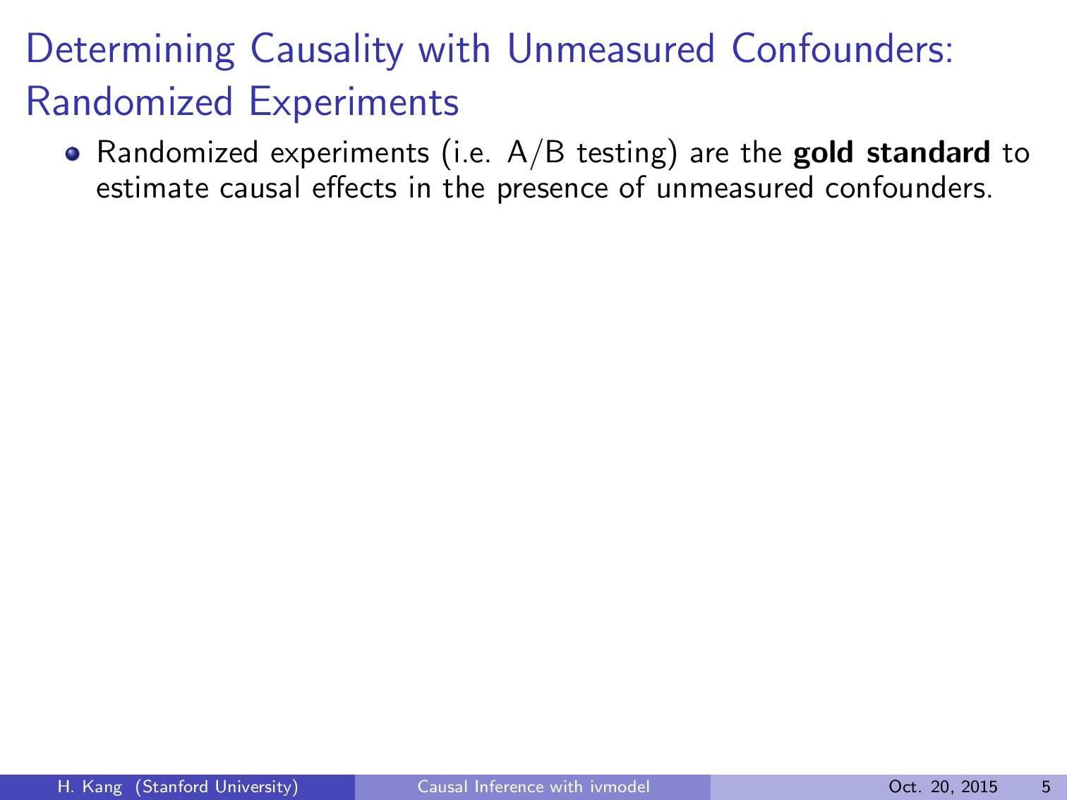

Slide 15
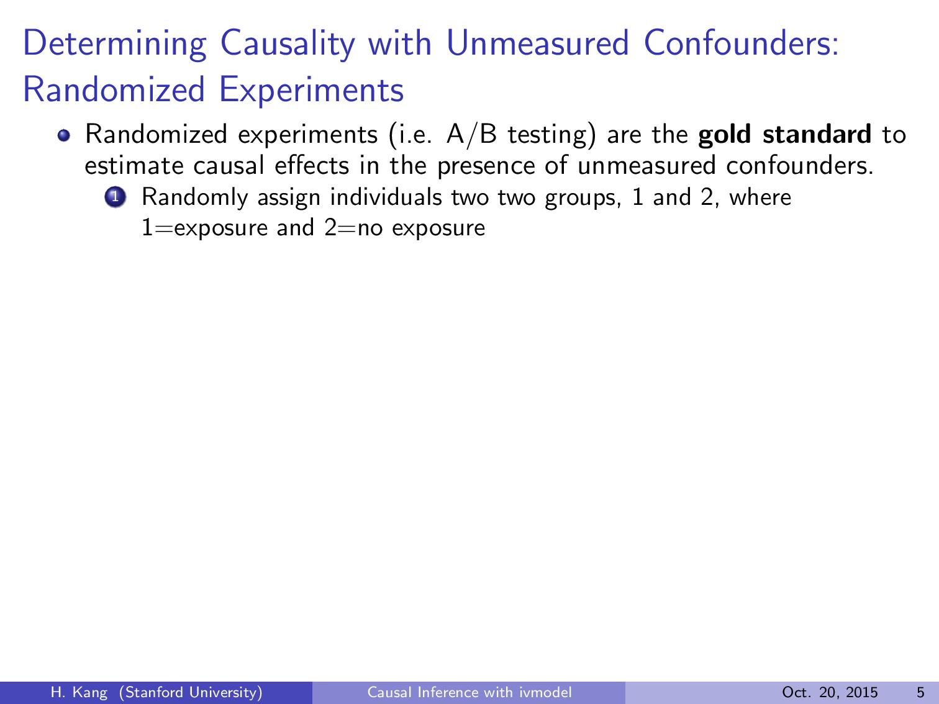

Slide 16
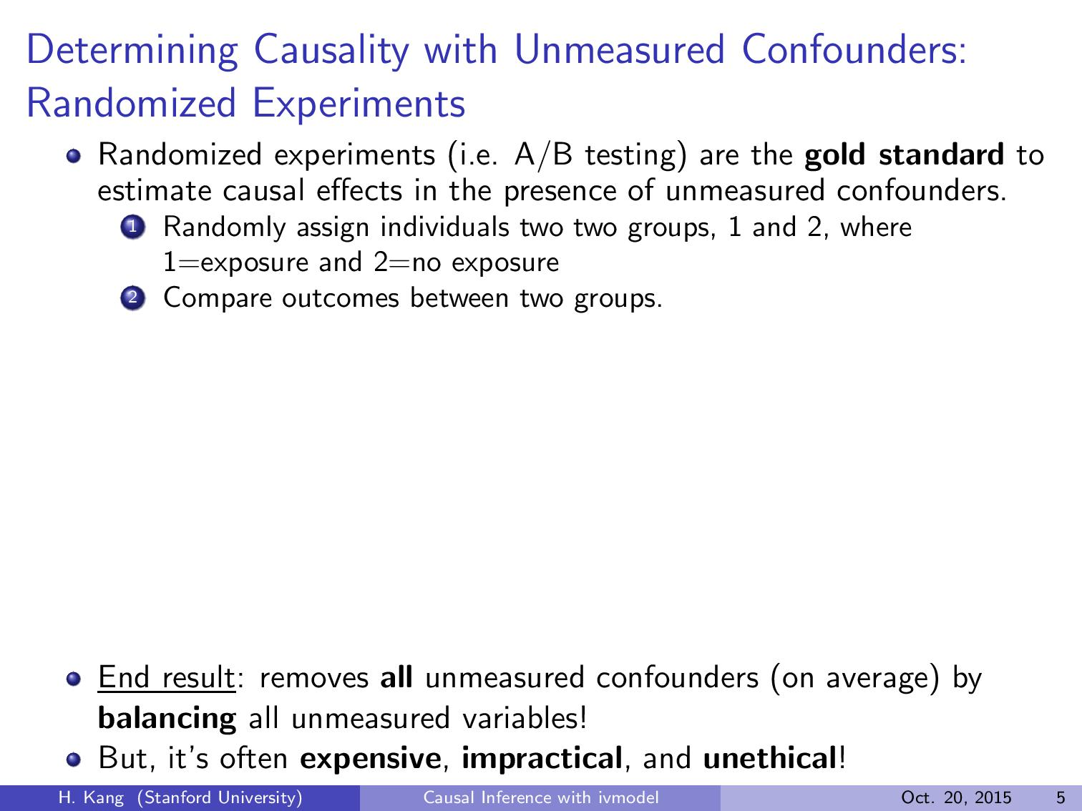
Unmeasured Confounders
(Ability)
College Graduates
No College
Exposure
(Edu)
Outcome
(Earning)
Directed Acyclic Graph (DAG) Representation
$30K income
$50K income
$60K income

Slide 17
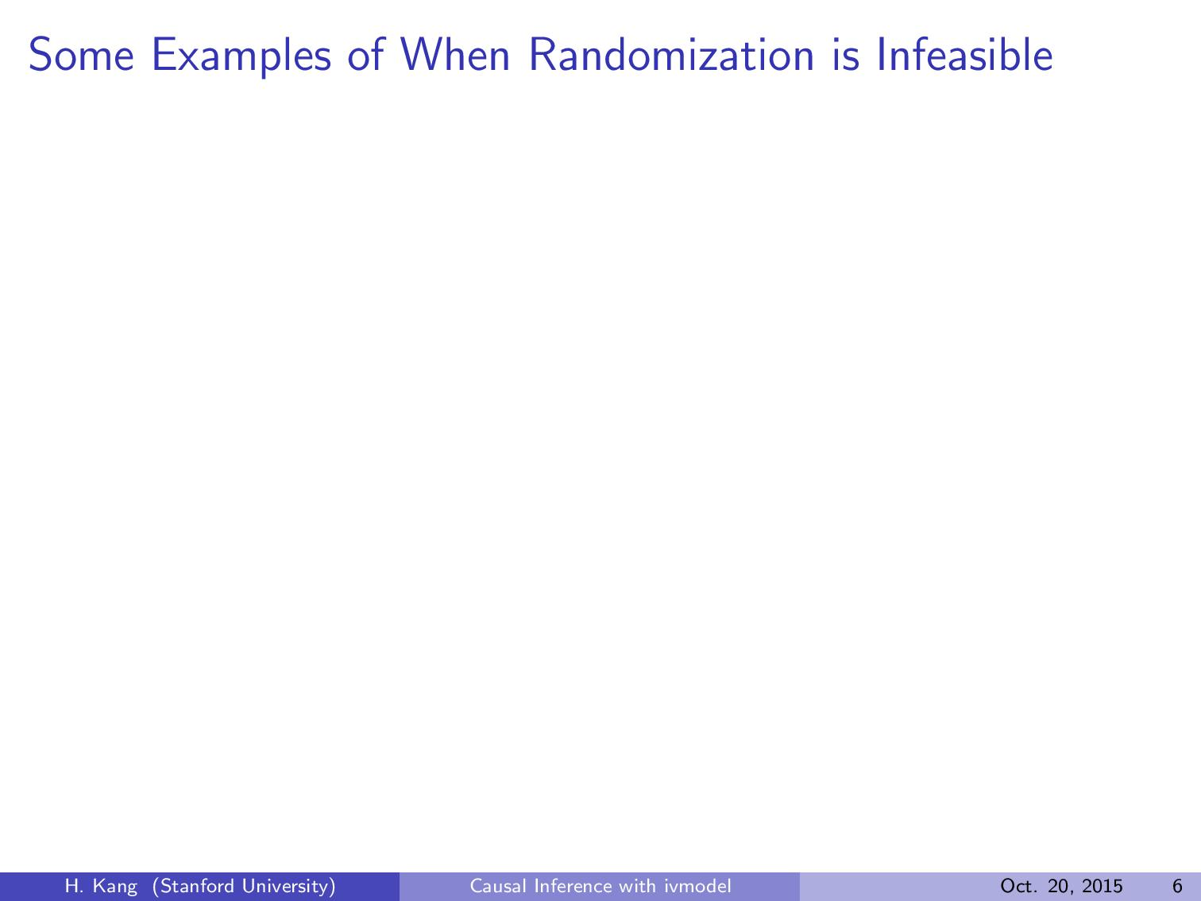

Slide 18
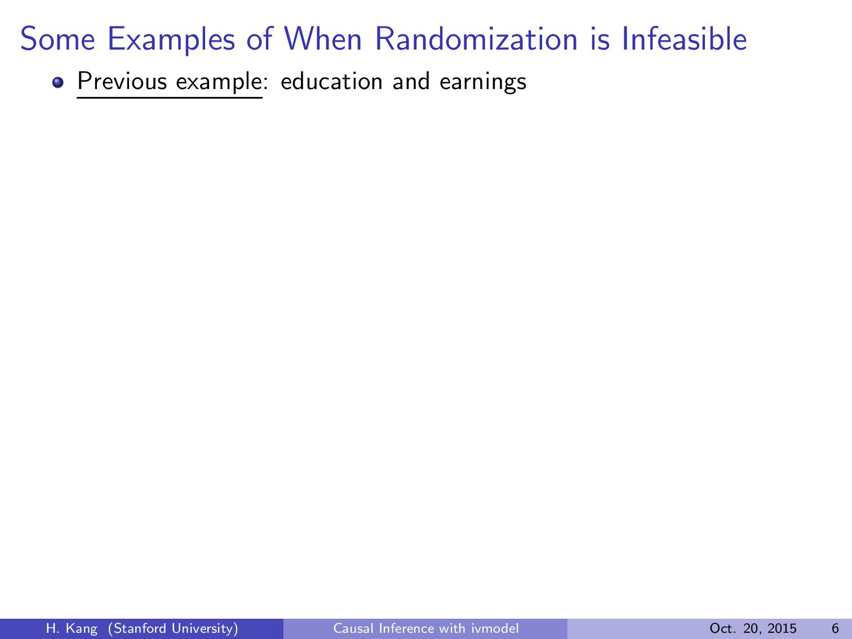

Slide 19
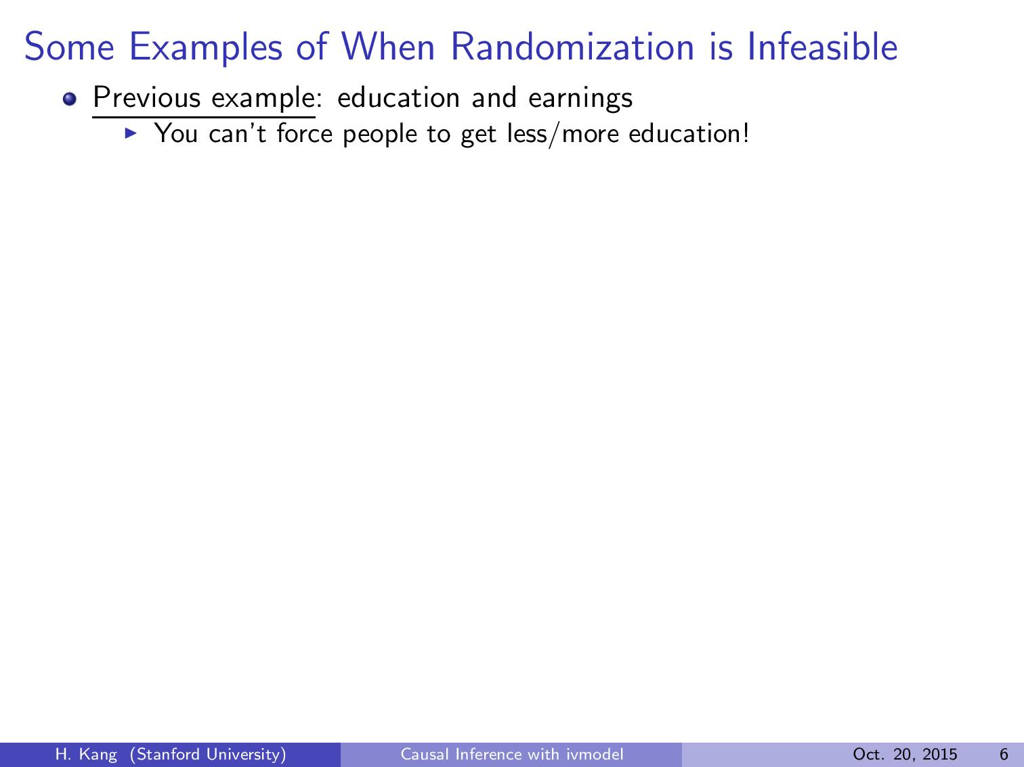

Slide 20
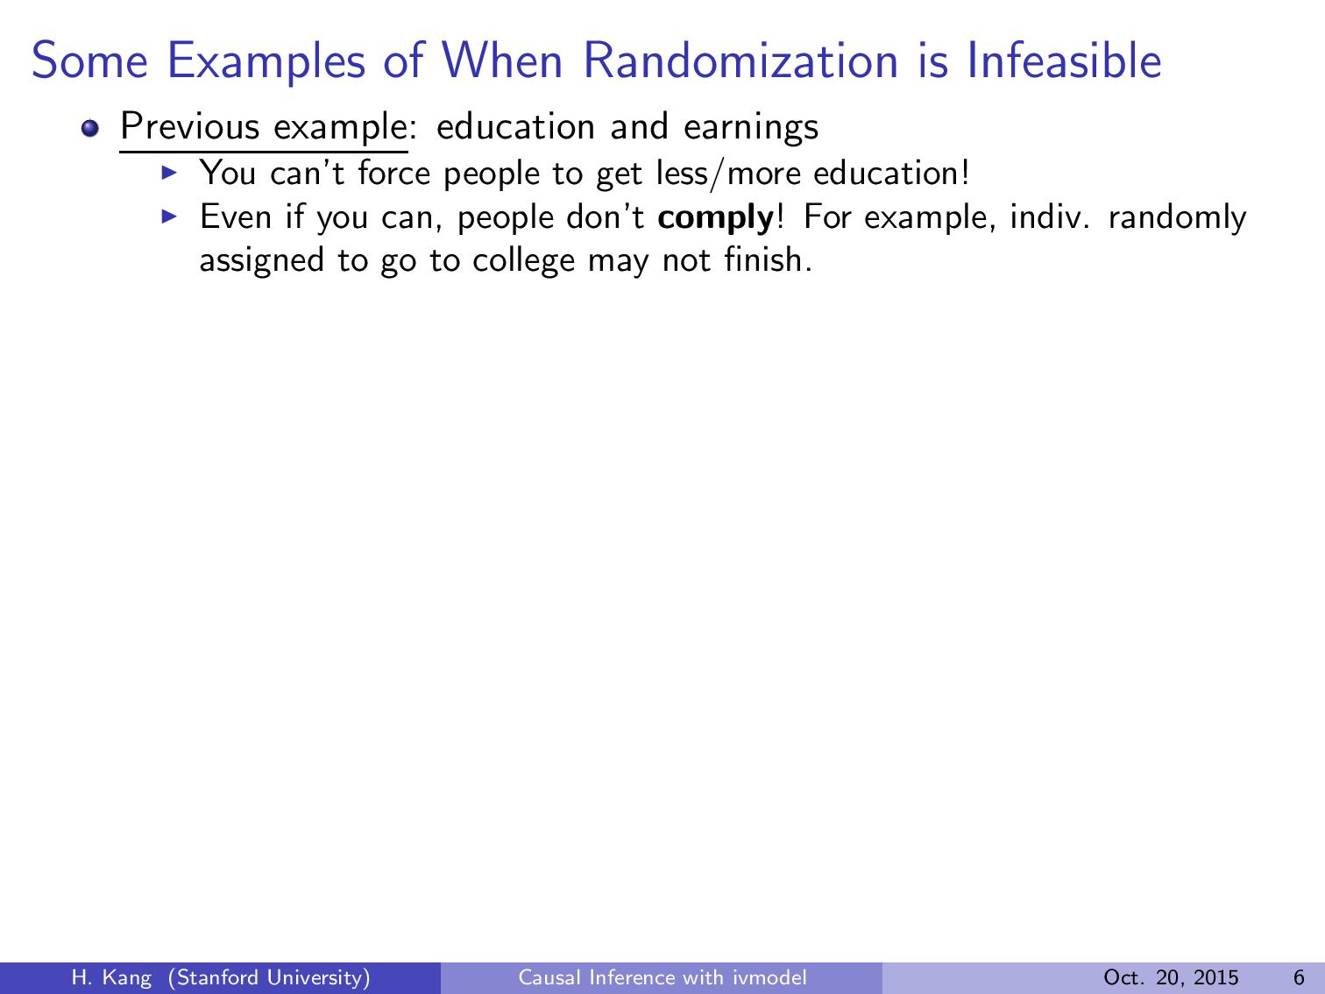

Slide 21
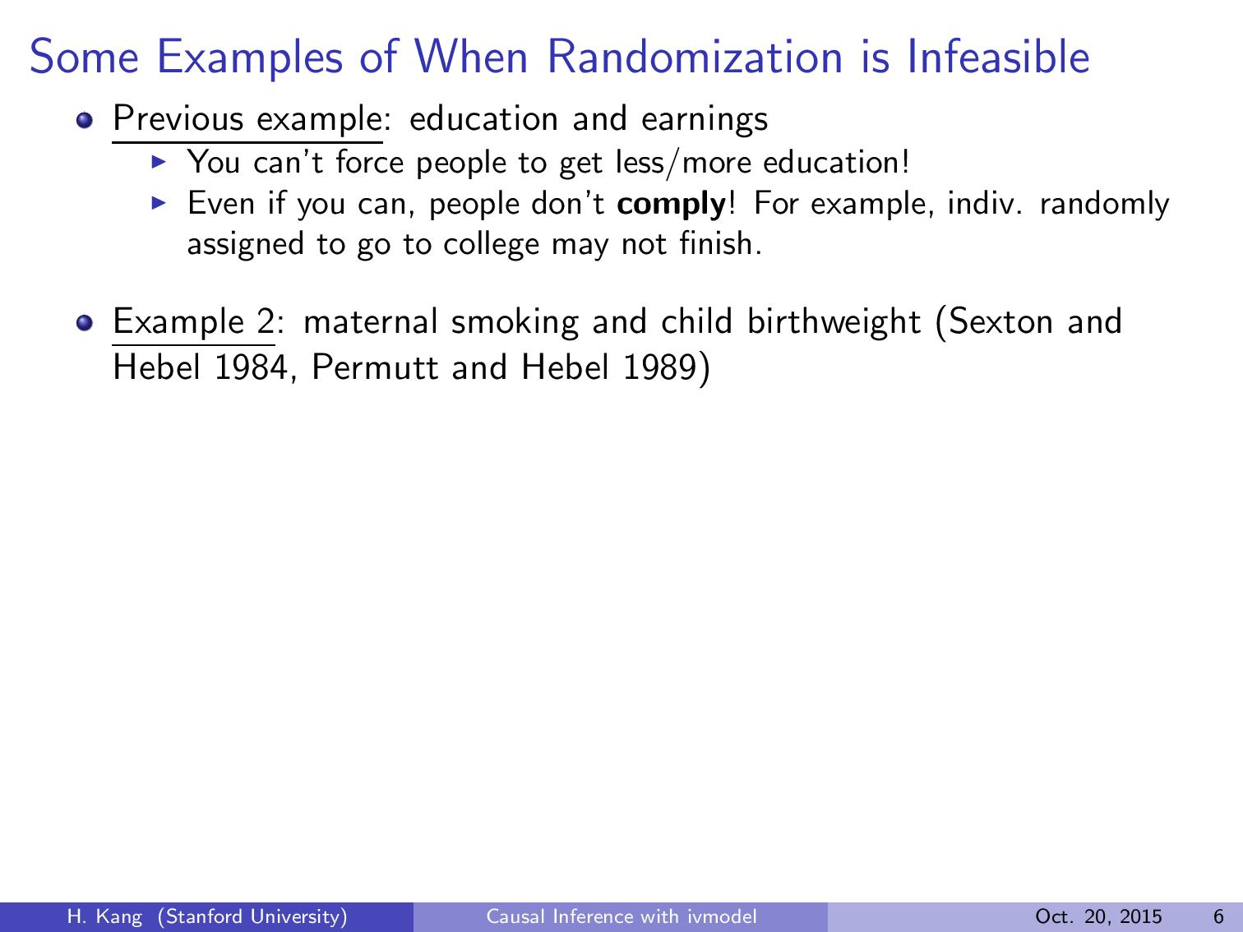

Slide 22
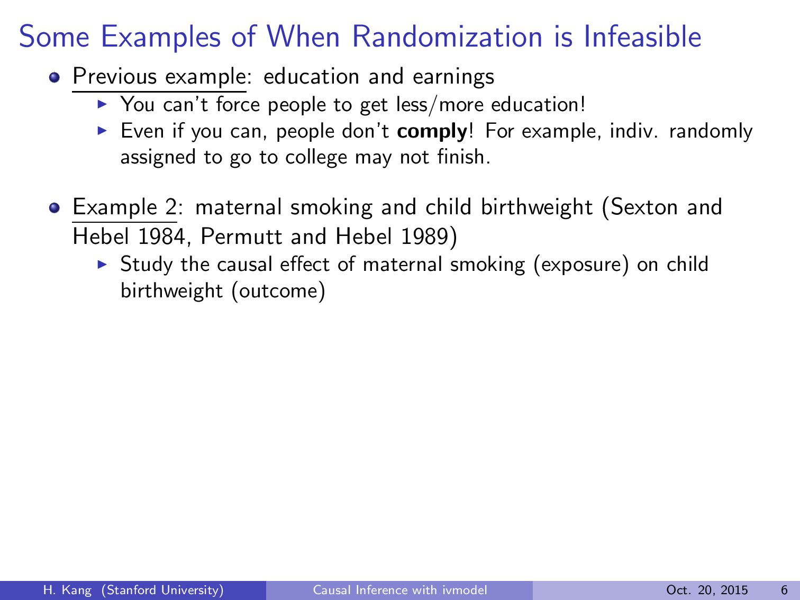

Slide 23
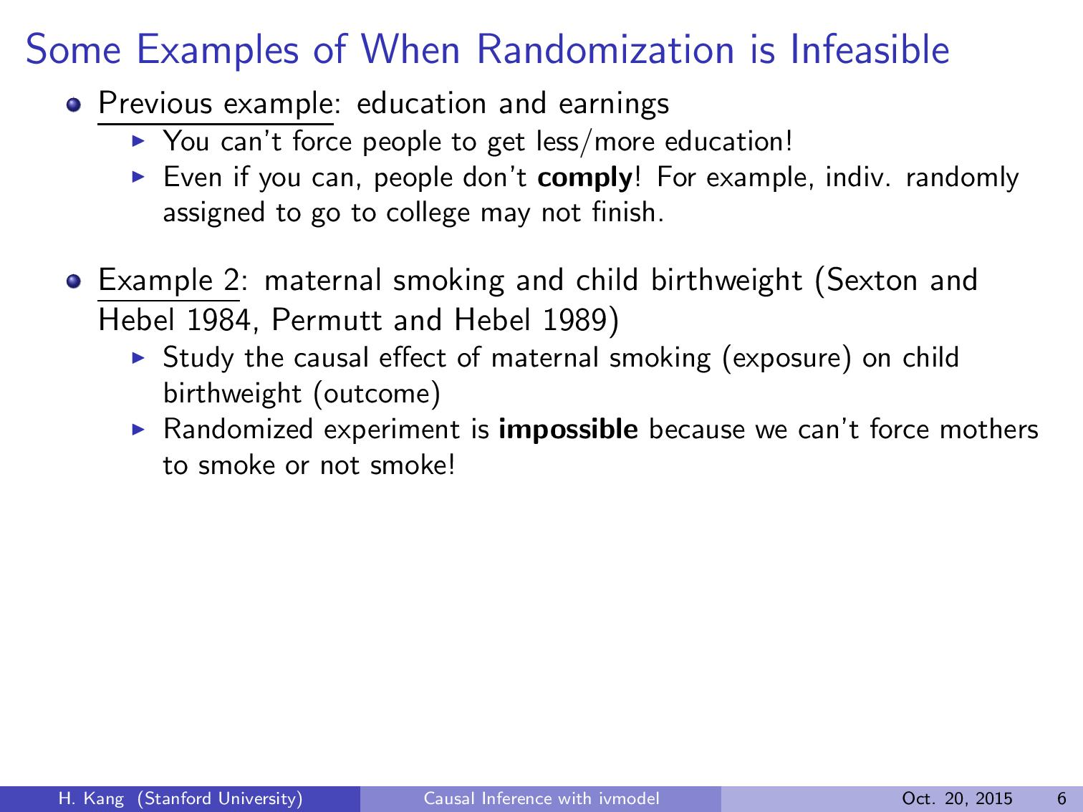

Slide 24
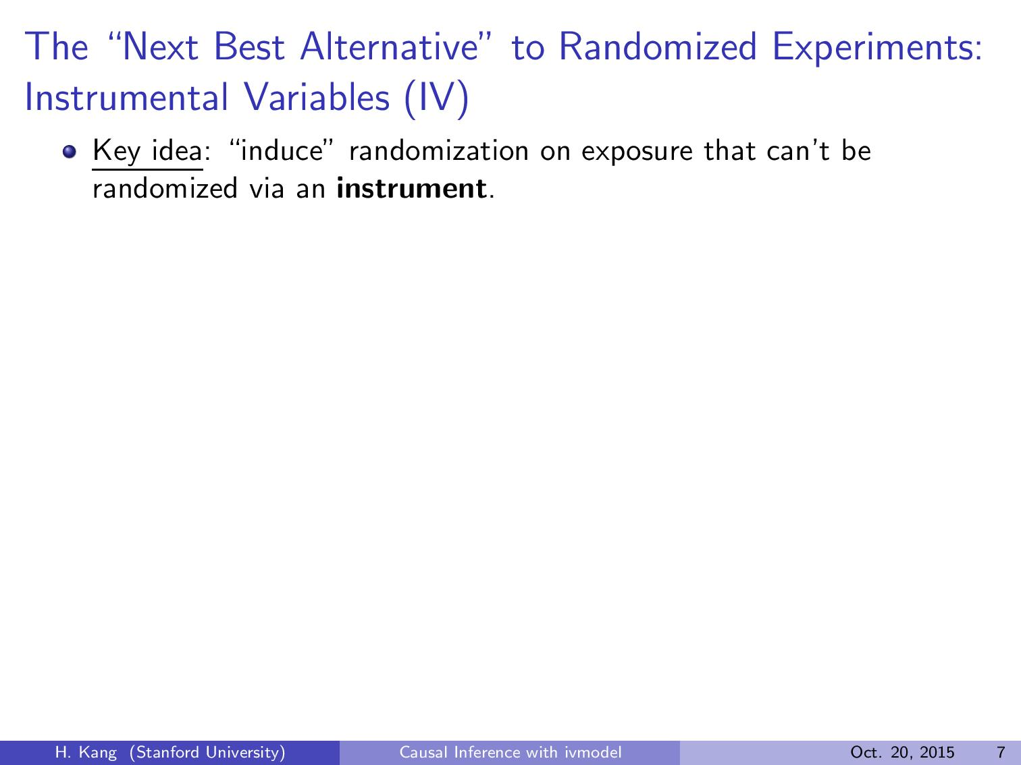
Unmeasured
Confounders
(e.g. Ability)
Assumption 3
No Unmeasured Confounders
Instrument (Z)
(e.g. proximity to college)
Exposure (D)
(e.g. Edu)
Outcome (Y)
(e.g. Earnings)
Assumption 1 Relevance
Assumption 2 Exclusion Restriction
The random instrument (by (A3)) ``injects’’ some randomness into the exposure via (A1) and only into the exposure (A2).
If all the assumptions are satisfied, instrument is valid and the causal effect can be estimated!

Slide 25


Slide 26
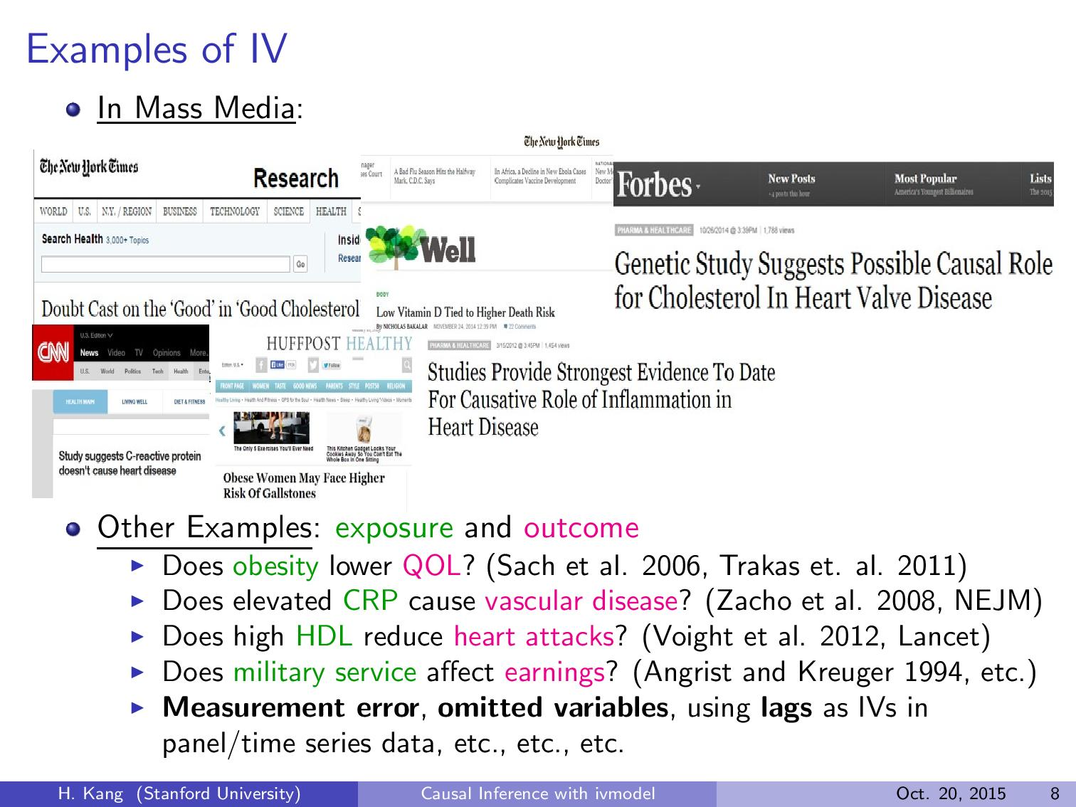

Slide 27

Steps for IV Analysis
1) Find IVs related to exposure.
2) Assume they meet other IV assumptions
3) Run two stage least squares (TSLS)
(regress D on Zs, then Y on predicted D)
# Dhat = predict(lm(D ~ Z)); coef(lm(Y ~ Dhat))
Assumption 3
No Unmeasured Confounders
Instrument (Z₁)
(proximity to 4yr college)
Unmeasured
Confounders
(Ability)
Instrument (Z₂)
(proximity to 2yr college)
Instrument (Z)
Exposure (D)
(Edu)
Outcome (Y)
(Earnings)
…
Assumption 1 Relevance
Assumption 2 Exclusion Restriction
Instrument (Z_{L})
(quarter of birth)

Slide 28


Slide 29


Slide 30
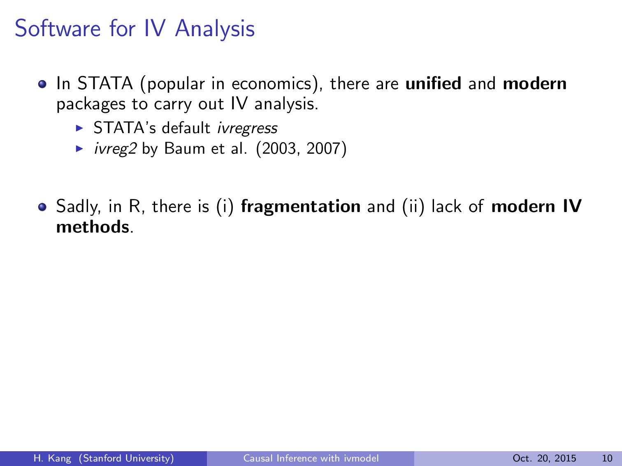

Slide 31
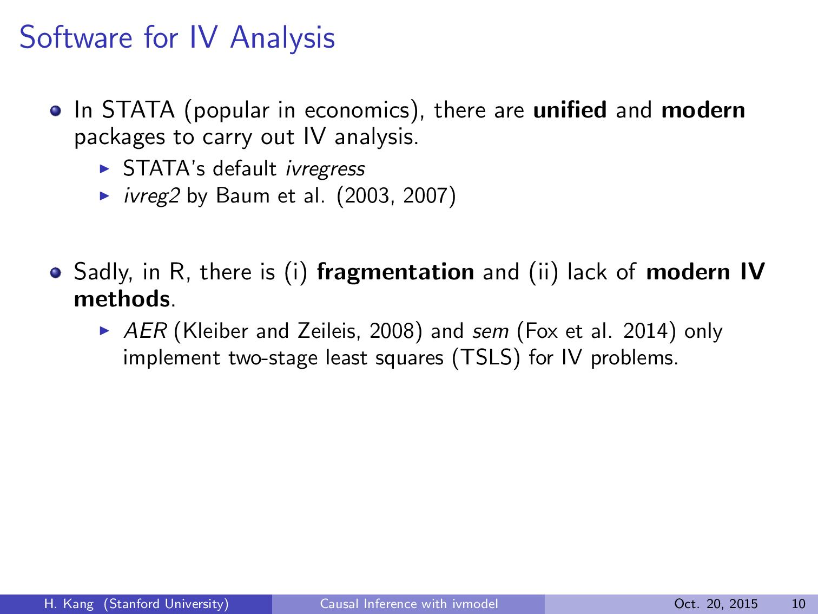

Slide 32
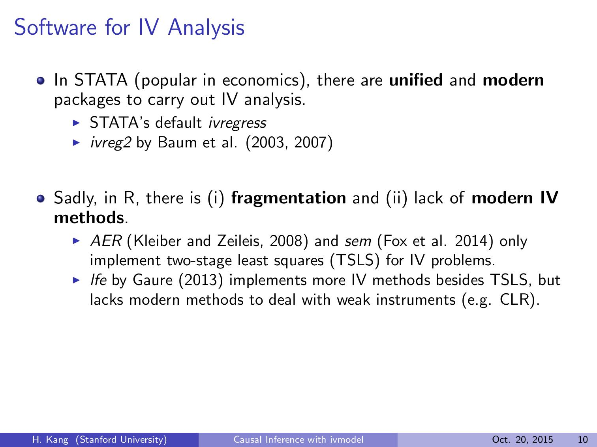

Slide 33
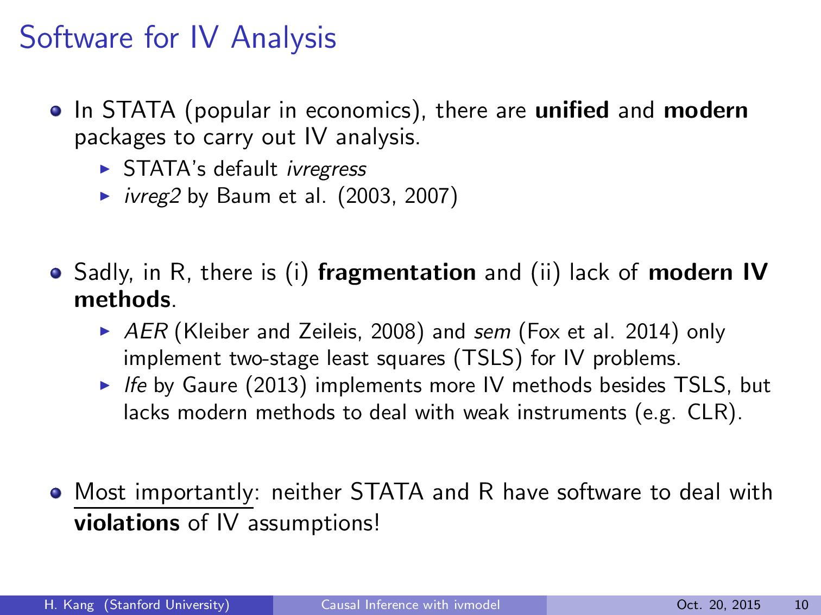

Slide 34


Choice to live near college towns may not be completely random!
Steps for IV Analysis
1) Find IVs related to exposure.
2) Assume they meet other IV assumptions
3) Run two stage least squares (TSLS)
(regress D on Zs, then Y on predicted D)
# Dhat = predict(lm(D ~ Z)); coef(lm(Y ~ Dhat))
Takeaway Point:
In practice, some IVs are not likely to completely satisfy all (A1)-(A3) assumptions.
(Barter et al. 2006 for survey)
Assumption 3
No Unmeasured Confounders
Instrument (Z₁)
(proximity to 4yr college)
Unmeasured
Confounders
(Ability)
Instrument (Z₂)
(proximity to 2yr college)
Instrument (Z)
Exposure (D)
(Edu)
Outcome (Y)
(Earnings)
…
Assumption 1 Relevance
Living close to colleges may provide indiv. with more opportunity besides edu.
Instrument (Z_{L})
(quarter of birth)
Assumption 2 Exclusion Restriction
Association may be weak, especially quarter of birth (Bound et al. 1995)

Slide 35


Slide 36
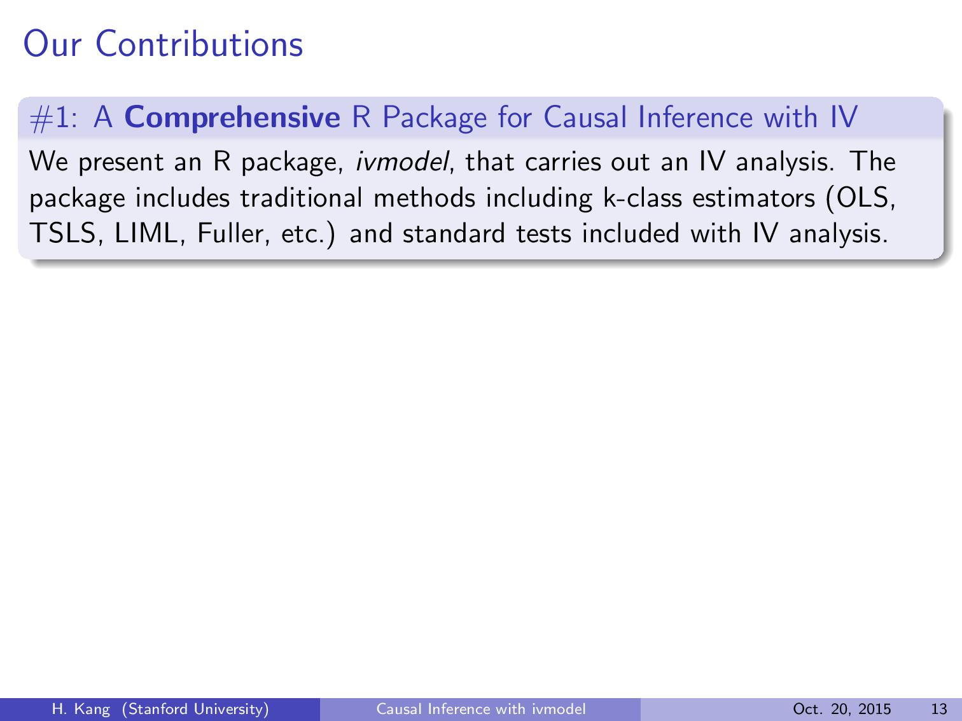

Slide 37
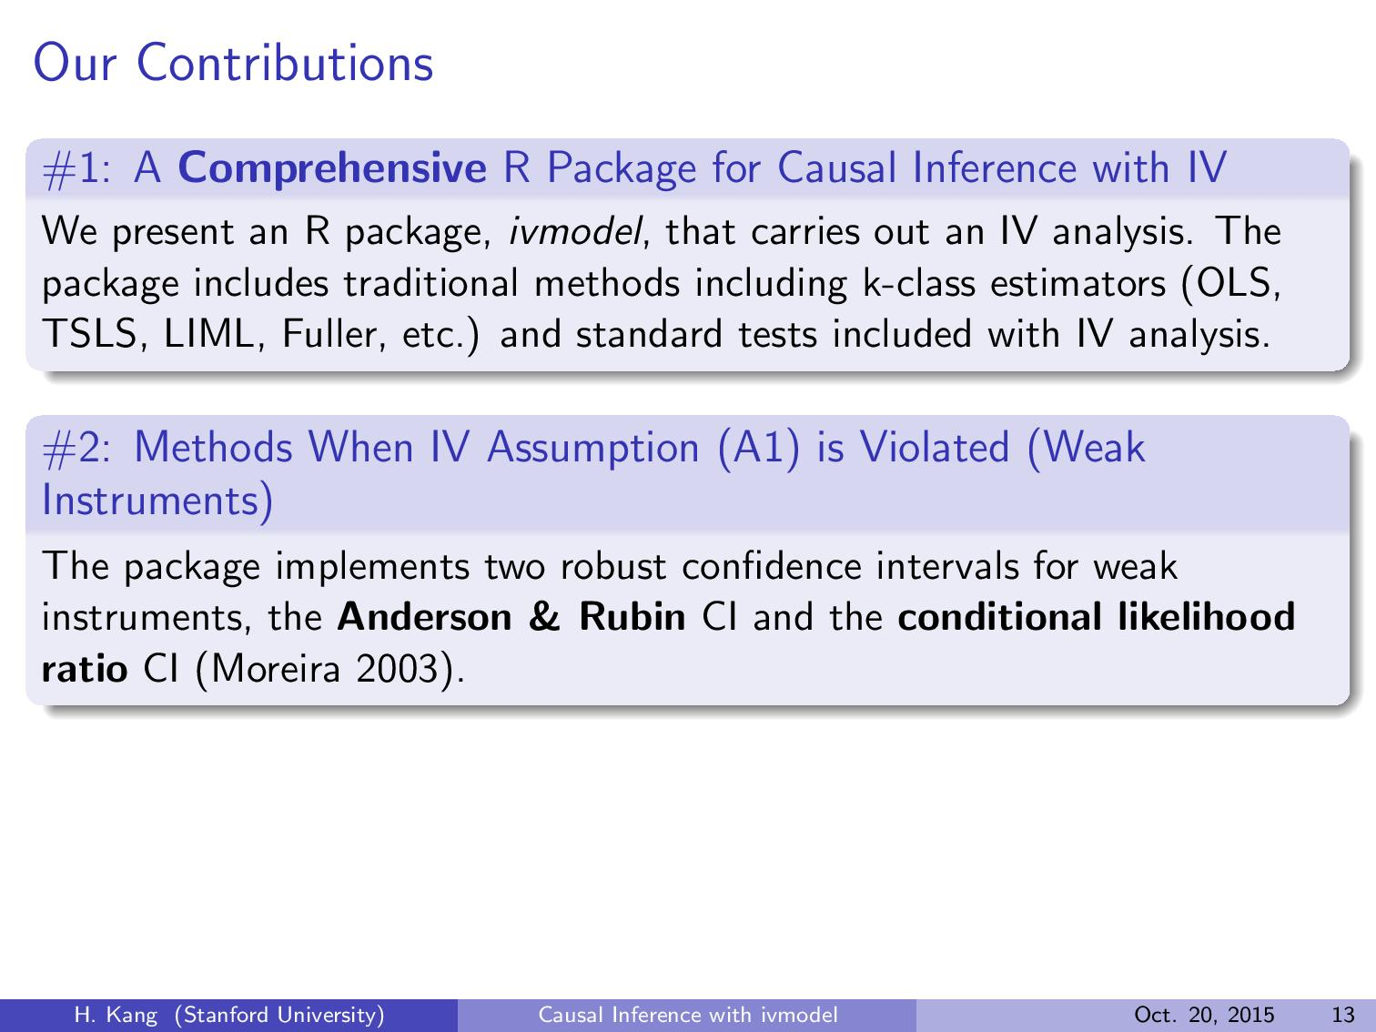

Slide 38
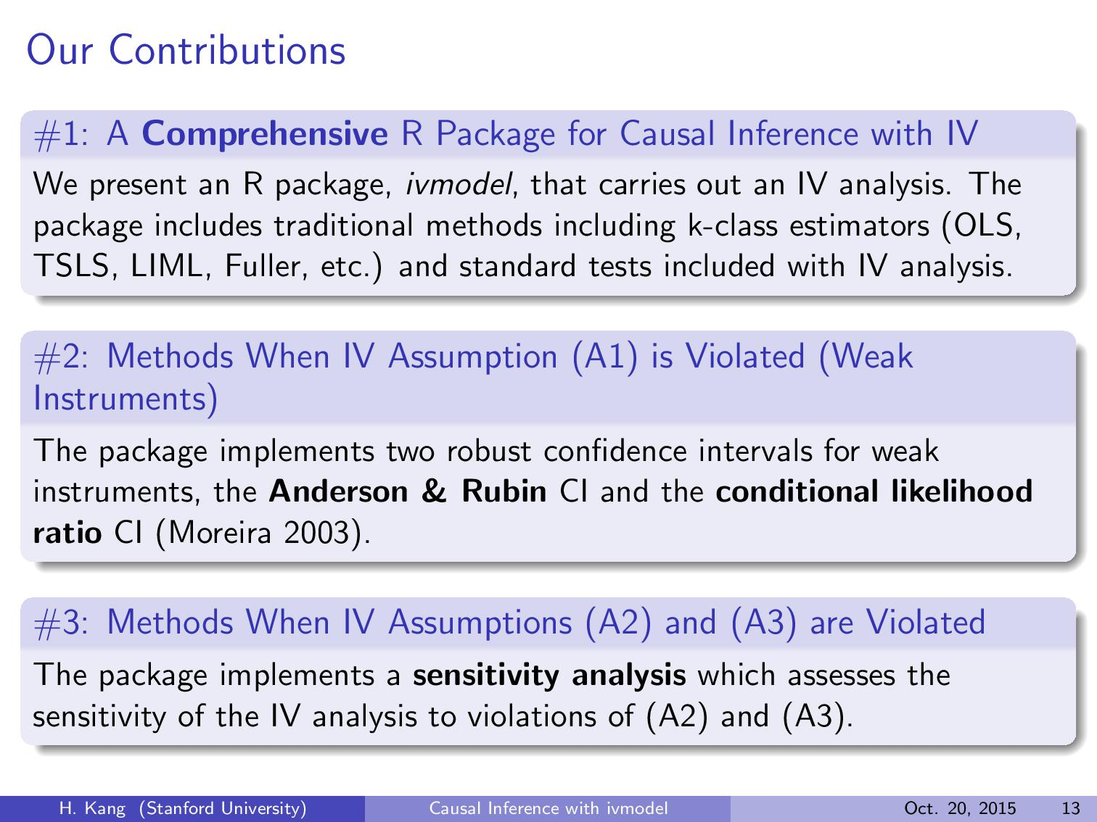

Slide 39
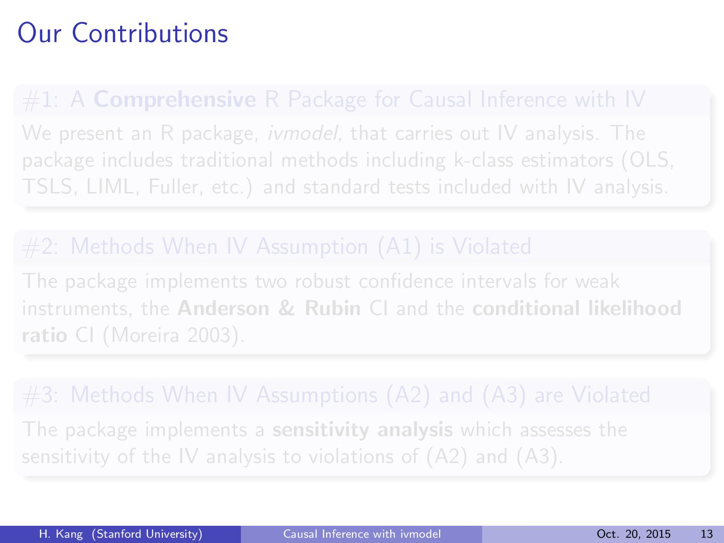
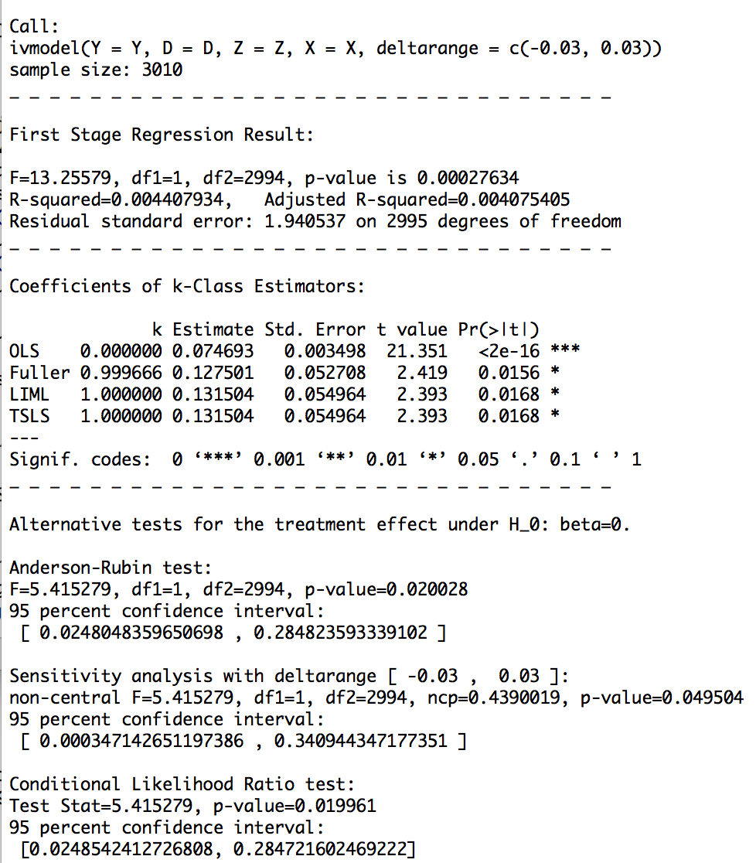
Summary statistics
Standard IV methods
Methods for violations of IV assumptions (A1)-(A3)

Slide 40


Slide 41
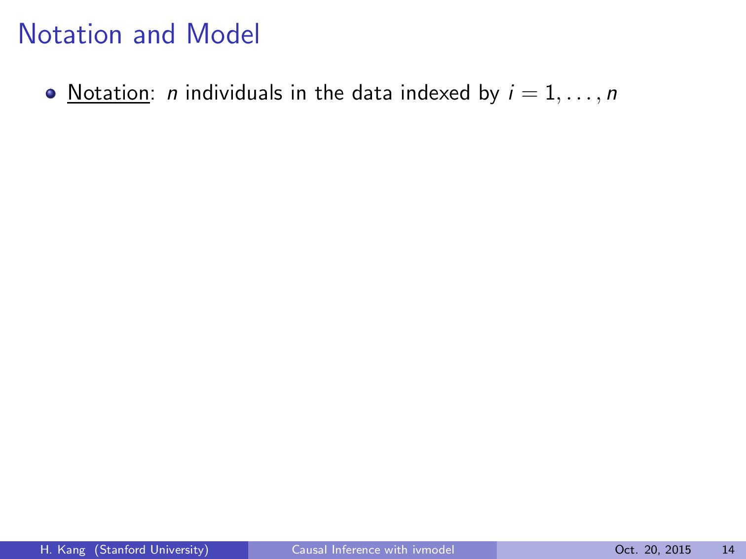

Slide 42
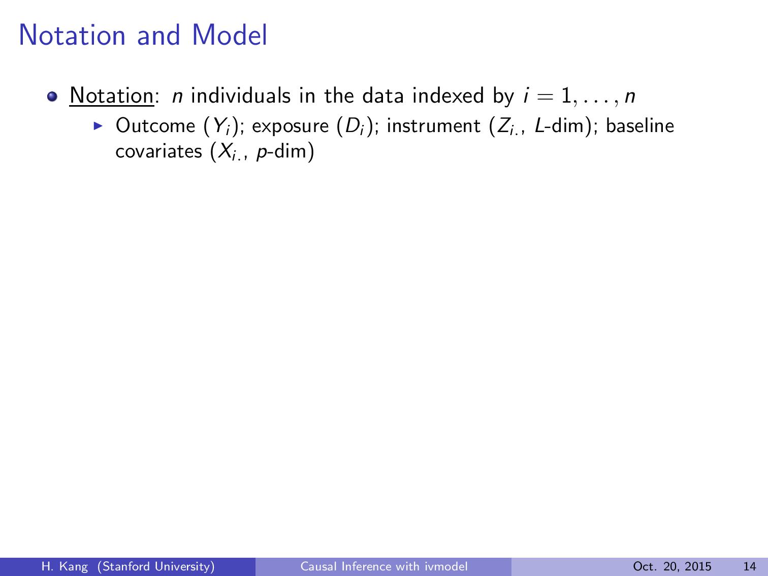

Slide 43
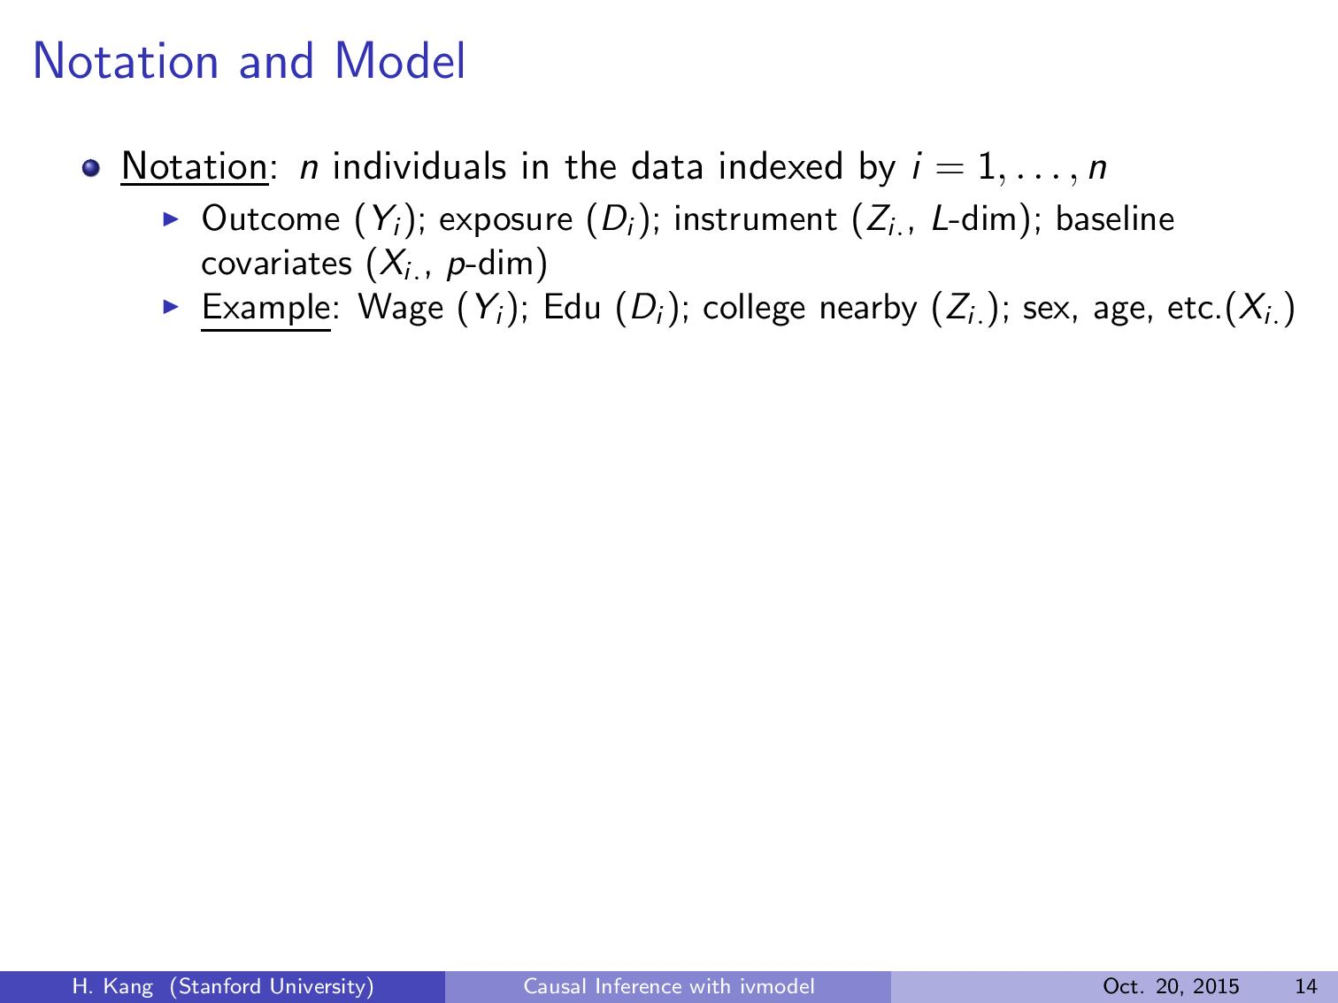

Slide 44
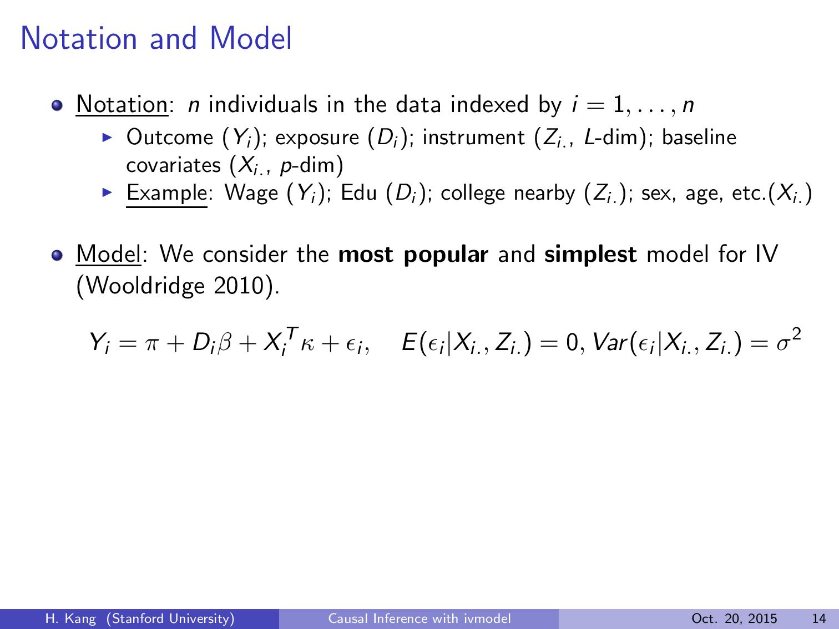

Slide 45
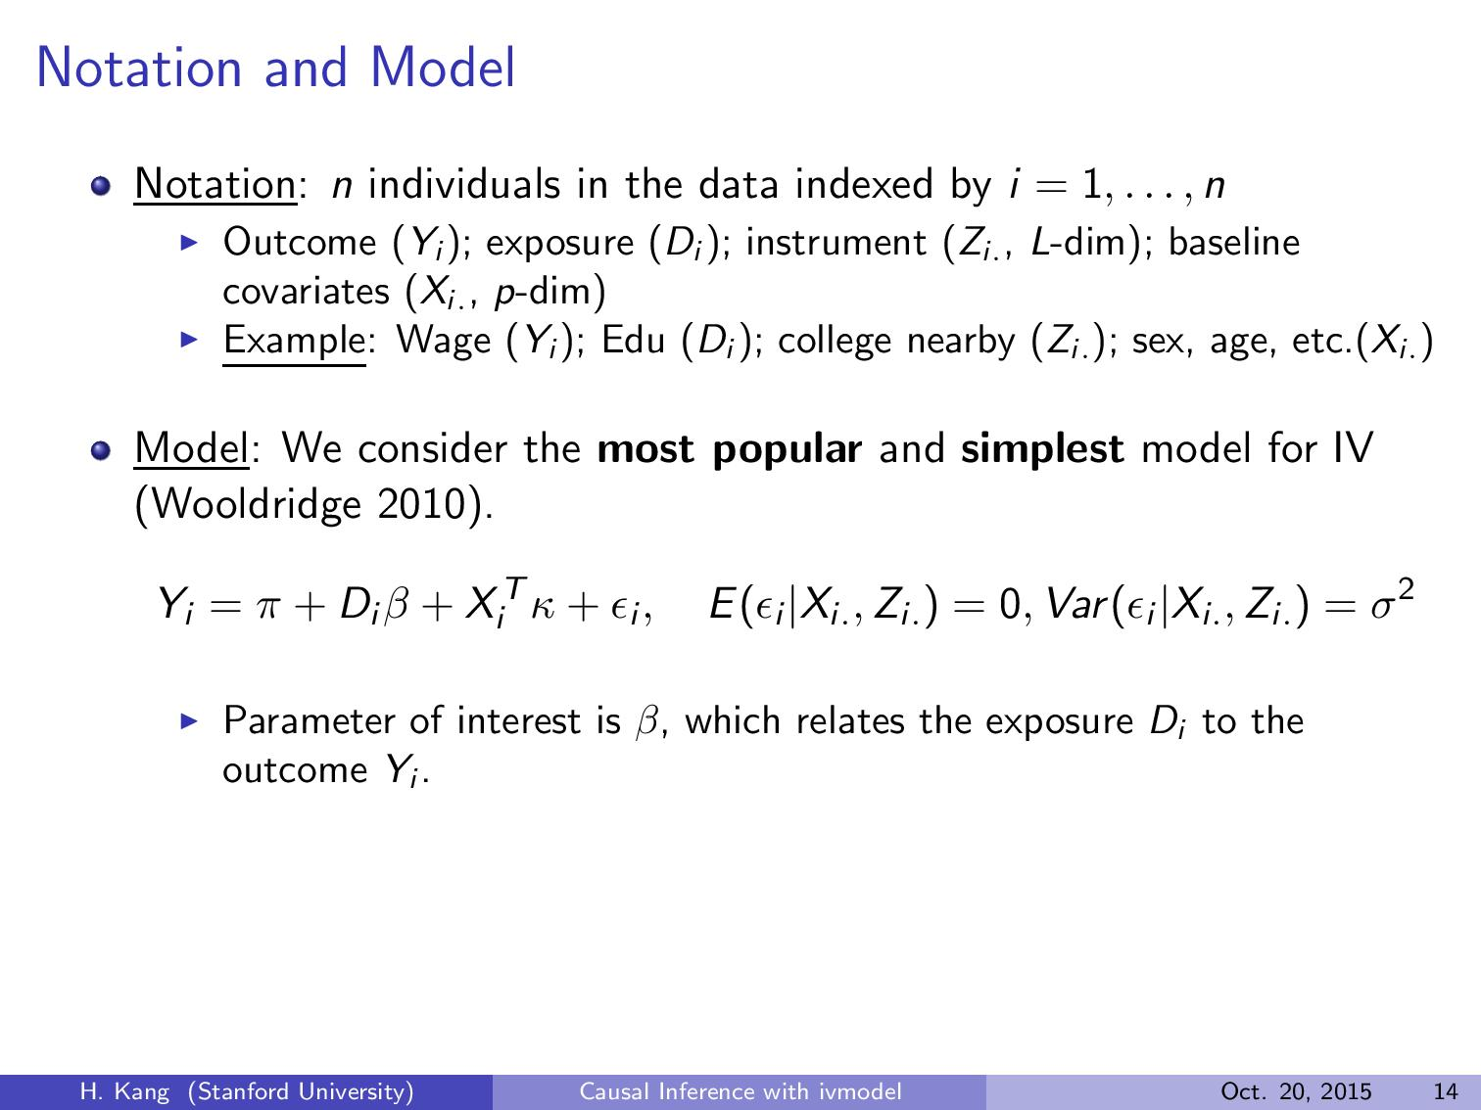

Slide 46
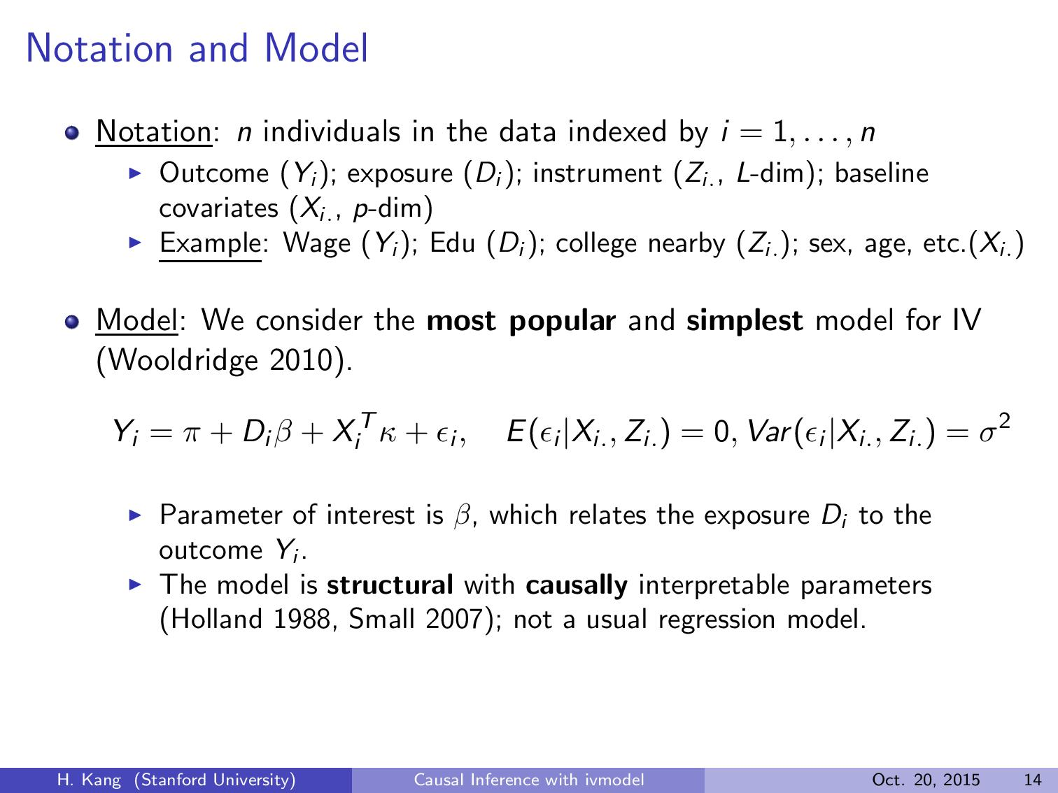

Slide 47
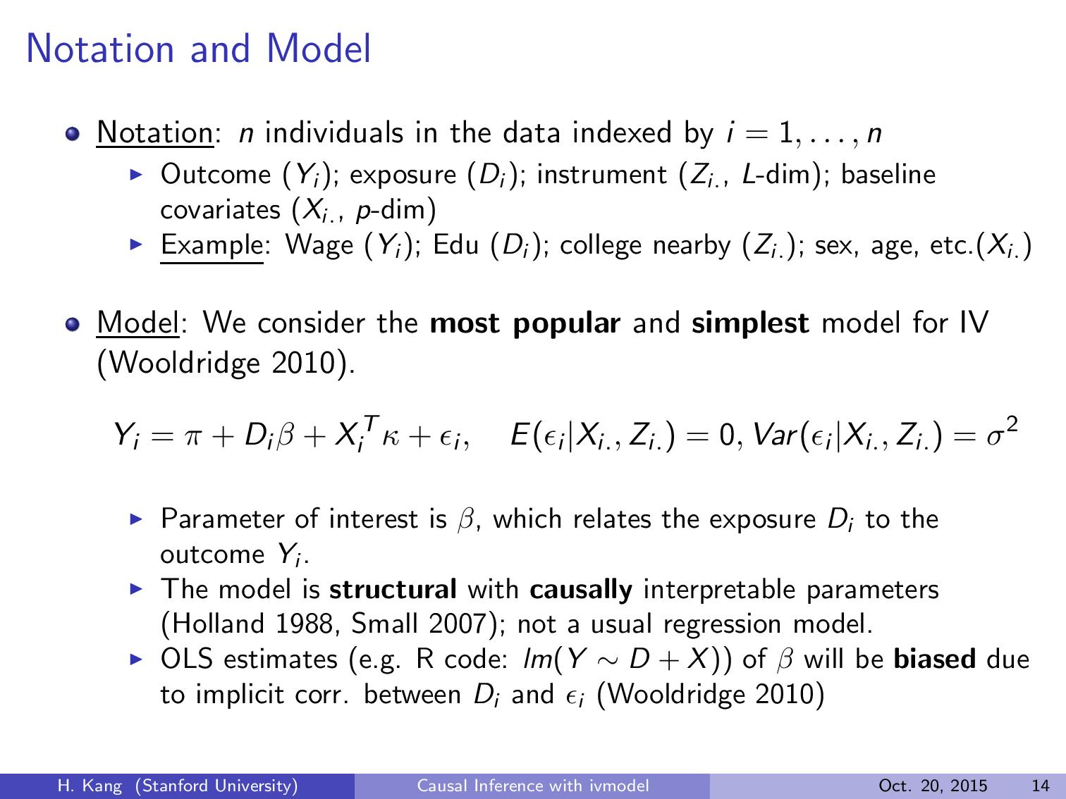

Slide 48
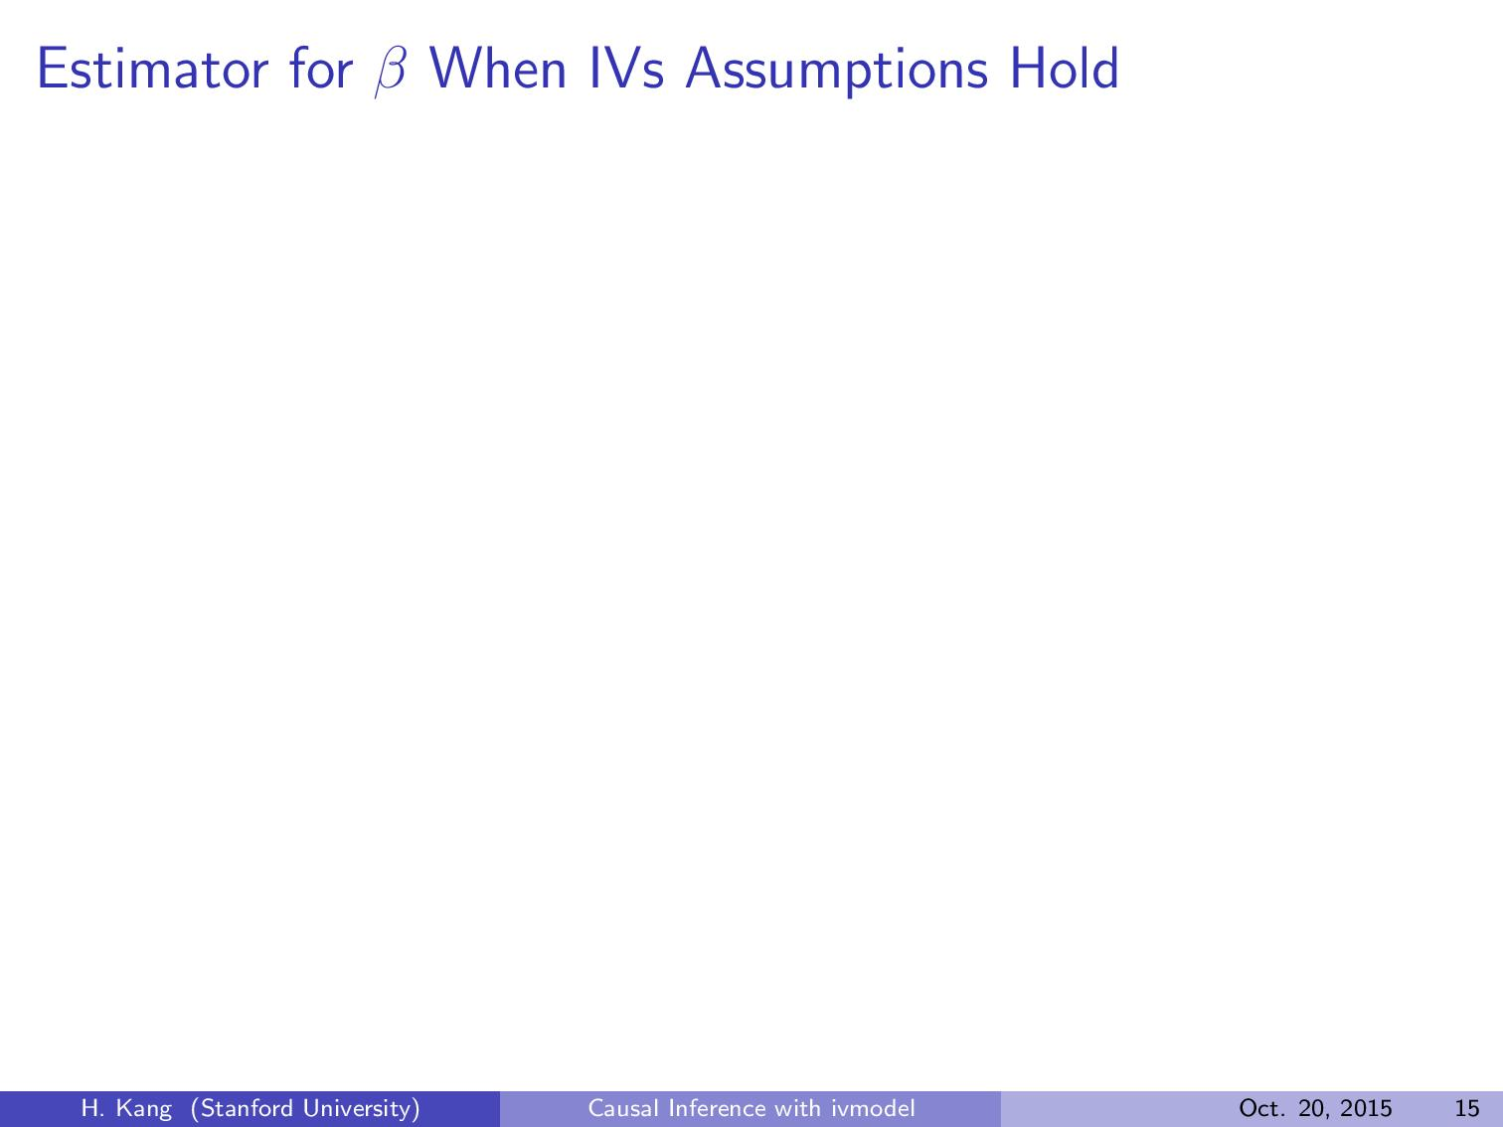

Slide 49
